Slide 1

DEPARTMENT OF DATA SCIENCE
MAJOR PROJECT
on
FUTURE OF LOAN APPROVALS WTH EXPLAINABLE -AI
BATCH NO:-5
SUBMITTED BY:
T. Varshitha (22D41A67B2)
P. Hari Krishna (22D41A6789)
S. Shiva Sai (22D41A67A8)
Y. Prasuna (22D1A67C5)
T. Koushik (23D45A6711)
INTERNAL GUIDE :
Ms. B.K.N PRIYANKA
(Assistant Professor)

Slide 2
CONTENTS
Abstract
Introduction
Existing system
Disadvantages of Existing system
Proposed system
Advantages of Proposed system Software Requirements
Hardware Requirements
System Architecture
UML diagrams
Code
Output
Conclusion

Slide 3
ABSTRACT
Widespread adoption of automated decision making by artificial intelligence(AI) is witnessed due to specular advances in computation power and improvements in optimization algorithms especially in machine learning (ML). Complex ML models provide good prediction accuracy; however, the opacity of ML models does not provide sufficient assurance for their adoption in the automation of lending decisions. This paper presents an explainable AI decision-support-system to automate the loan underwriting process by belief-rule-base (BRB).This system can accommodate human knowledge and can also learn from historical data by supervised learning.The hierarchical structure of BRB can accommodates factual and heuristic rules. The system can explain the chain of events leading to a decision for a loan application by the importance of an activated rule and the contribution of antecedent attributes in the rule. A business case study on automation of mortgage underwriting is demonstrated to show that the BRB system can provide a good trade-off between accuracy and explainability. The textual explanation produced by the activation of rules could be used as a reason for denial of a loan. The decision- making process for an application can be comprehended by the significance of rules in providing the decision and contribution of its antecedent attributes.

Slide 4
INTRODUCTION
Underwriting skill is learnt through several months of training and exchange of knowledge by senior underwriters. This task requires underwriters to be fairly analytical, very organized, and accurate to give informed decision to approve or reject a loan application. Underwriters concurrently analyze a large quantity of information to find affordability, repayment history and collateral. Furthermore, sometimes they are required to change the process due to a shift in regulatory and compliance standards, investor requirements, and customer demands (Krovvidy, 2008). New technology and strong machine learning (ML) algorithms have opened the doors for a straight through loan application process. Artificial intelligence (AI) systems can execute rules and process customers‟ information in a few milliseconds. Financial institutions have recognized the benefits of AI and are using it in a different subset of the underwriting process and are keen to test and implement newly introduced digital innovation. AI systems are expected to replicate human decision-making skills. However, even today transformation of various algorithmic concepts into training data could be very challenging to solve every instance of the problem for a range of lending products. It may not be able to solve a tiny subset of the problem(Aggour, Bonissone, Cheetham, & Messmer, 2006)

Slide 5
EX ISTING SYSTEM
In the existing system, loan approvals are handled either manually by bank officers or through traditional automated systems based on fixed rules and basic machine learning models.
These systems use parameters like credit score, income, employment status, previous loan history, and outstanding debts to decide whether an applicant is eligible for a loan.
While this approach speeds up decision-making compared to fully manual processes, most of these systems work like a “black box,” meaning they give a final decision without explaining the reasoning behind it.

Slide 6
DISADVANTAGES OF EXISTING SYSTEM
Lack of Transparency
Bias in Decision-Making
Low Customer Trust
Difficult Regulatory Compliance
Limited Error Detection

Slide 7
PROPOSED SYSTEM
The proposed system uses Explainable AI (XAI) techniques along with machine learning models to make loan approval decisions both accurate and transparent.
It not only predicts whether a loan should be approved or rejected but also explains why that decision was made.
Methods such as SHAP (SHapley Additive explanations) or LIME (Local Interpretable Model-Agnostic Explanations) highlight the most important features—like income level, credit score, and repayment behavior—that influenced the decision.
This approach improves fairness, accountability, and user trust.

Slide 8
ADVANTAGS OF PROPOSED SYSTEM
Improved Transparency
Fair and Bias-Aware Decisions
Higher Customer Trust
Better Regulatory Compliance
Improved Decision Quality
Personalized Feedback for Applicants

Slide 9
HARDWARE REQUIREMENTS
System : MINIMUM i3.
Hard Disk : 40 GB.
RAM : 4 GB.

Slide 10
SOFTWARE REQUIREMENTS
Operating System: Windows 8
Coding Language: Python 3.7

Slide 11
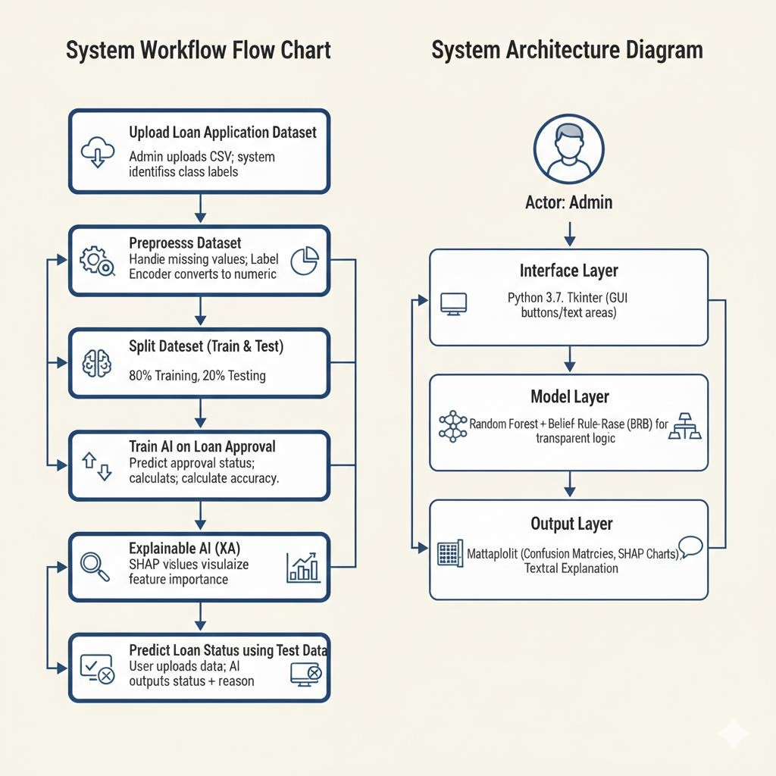
SYSTEM ARCHITECTURE

Slide 12
UML DIAGRAMS
UML is a standard visual language used to design and model object-oriented software
systems.
It helps developers visualize, plan, and document the structure and behavior of a system using
diagrams.
UML is independent of programming languages and development processes.
It provides a common way for teams to understand and communicate system designs.
UML supports best software engineering practices for building large and complex systems.
It is widely used in software development for clear and effective system modeling.

Slide 13
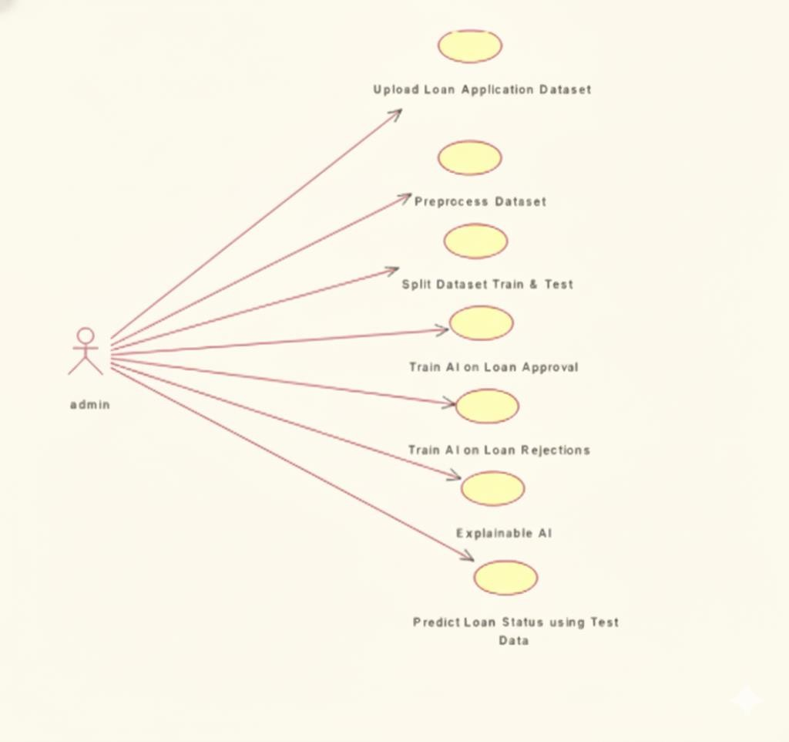
USE CASE DIAGRAM

Slide 14
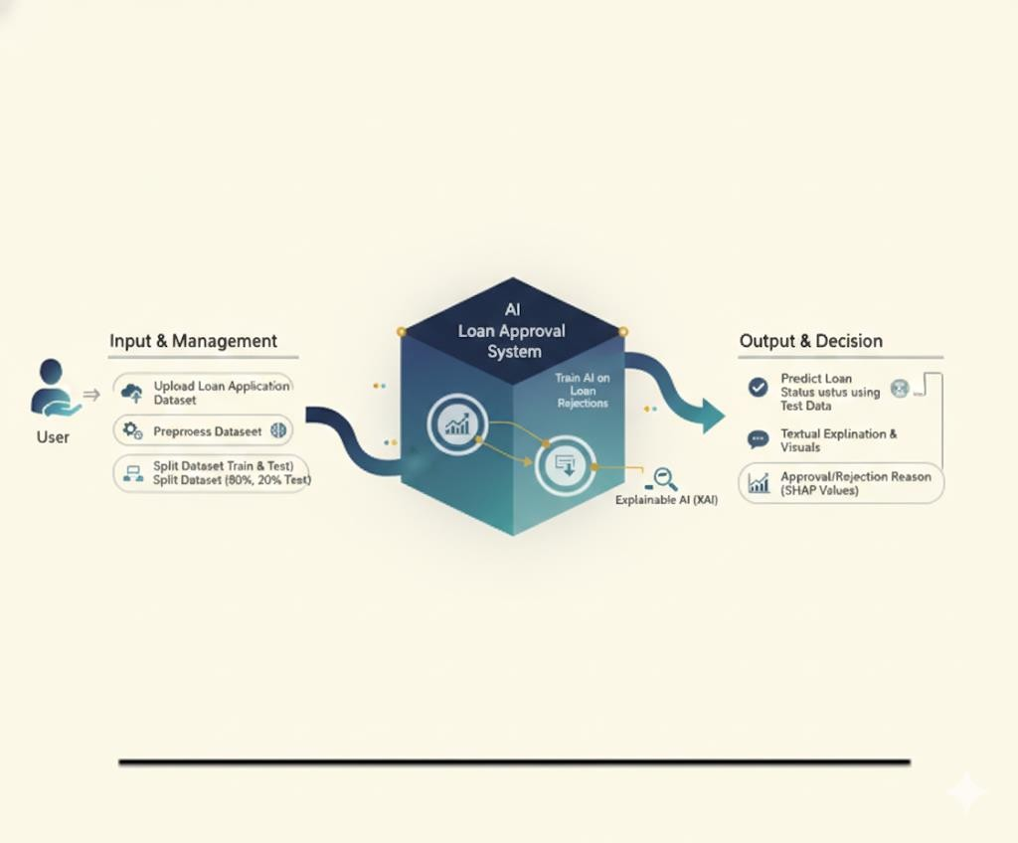
CLASS DIAGRAM

Slide 15
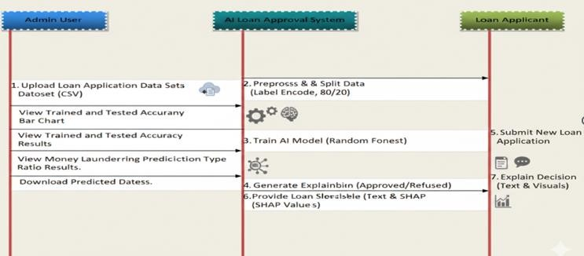
SEQUENCE DIAGRAM

Slide 16
CODE
def processDataset():
# Convert non-numeric (object) data to numeric using LabelEncoder for i, col_type in enumerate(dataset.dtypes):
if col_type == 'object': le = LabelEncoder()
dataset[dataset.columns[i]] = le.fit_transform(dataset[dataset.columns[i]].astype(str)) label_encoder.append(le)
# Feature Scaling (Normalization)
scaler = StandardScaler()
X = scaler.fit_transform(dataset.drop(['NAME_CONTRACT_STATUS', 'CODE_REJECT_REASON'], axis=1))
# 80/20 Train-Test Split
loan_X_train, loan_X_test, loan_y_train, loan_y_test = train_test_split(X, loan_status, test_size=0.2)

Slide 17
CODE
def trainModels():
# Model 1: Predicting Loan Approval Status rf = RandomForestClassifier() rf.fit(loan_X_train, loan_y_train)
# Model 2: Predicting Specific Rejection Reasons reject_rf = RandomForestClassifier()
reject_rf.fit(reject_X_train, reject_y_train) # Evaluation (Example: Accuracy)
predict = rf.predict(loan_X_test)
accuracy = accuracy_score(loan_y_test, predict) * 100 # Visualization: Heatmap/Confusion Matrix
conf_matrix = confusion_matrix(loan_y_test, predict) sns.heatmap(conf_matrix, annot=True, cmap="viridis")

Slide 18
CODE
def explainAI():
# Using SHAP (SHapley Additive exPlanations) for Transparency explainer = shap.TreeExplainer(rf)
# Calculate SHAP values for the first 200 test samples shap_values = explainer.shap_values(loan_X_test[0:200]) # Generate Summary Plot to show feature importance
shap.summary_plot(shap_values, feature_names=features_names) plt.show()
def predict(test_data):
# Apply saved scaler and encoders to new data X = scaler.transform(test_data)
status = rf.predict(X)
reason = reject_rf.predict(X) return status, reason

Slide 19
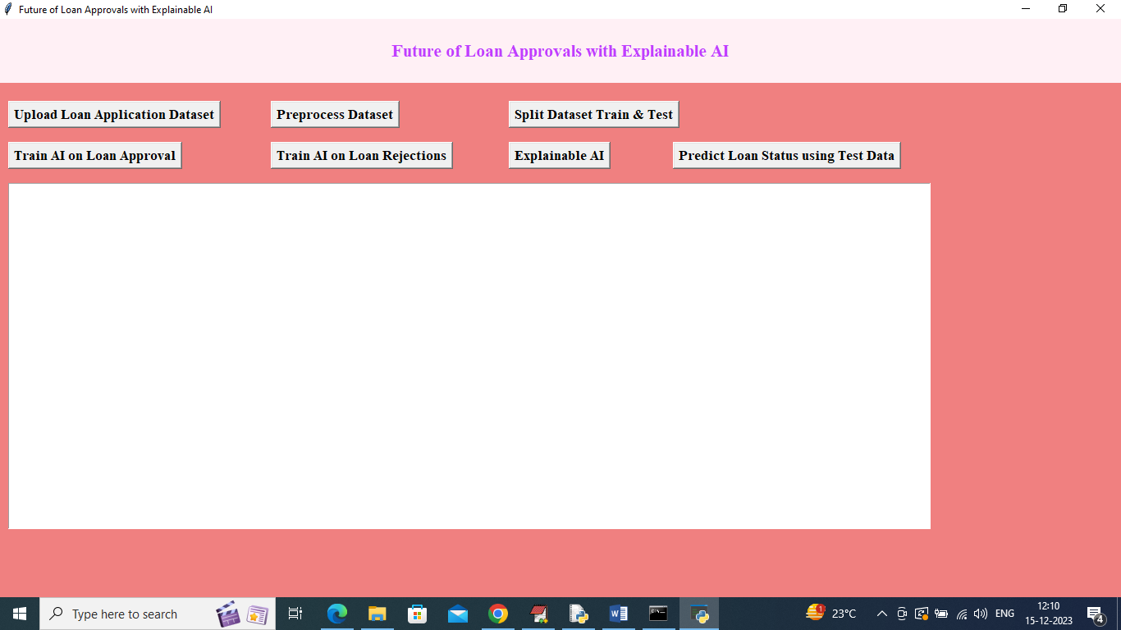
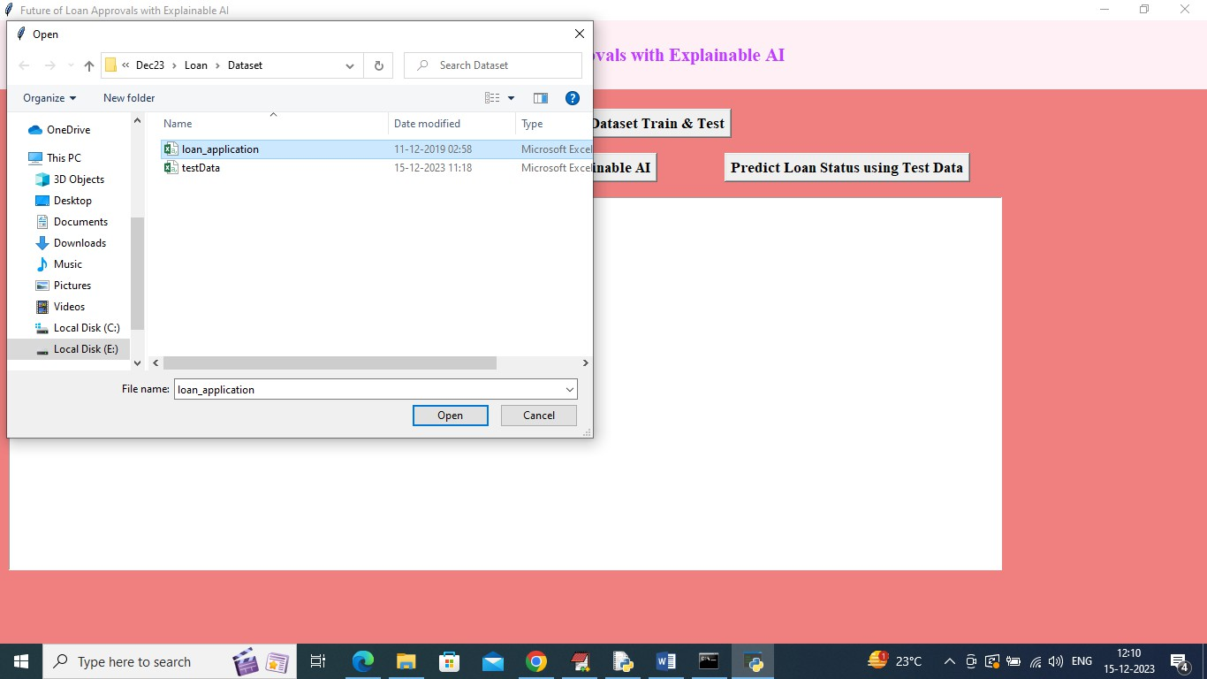
OU T P U T SCREENS

Slide 20
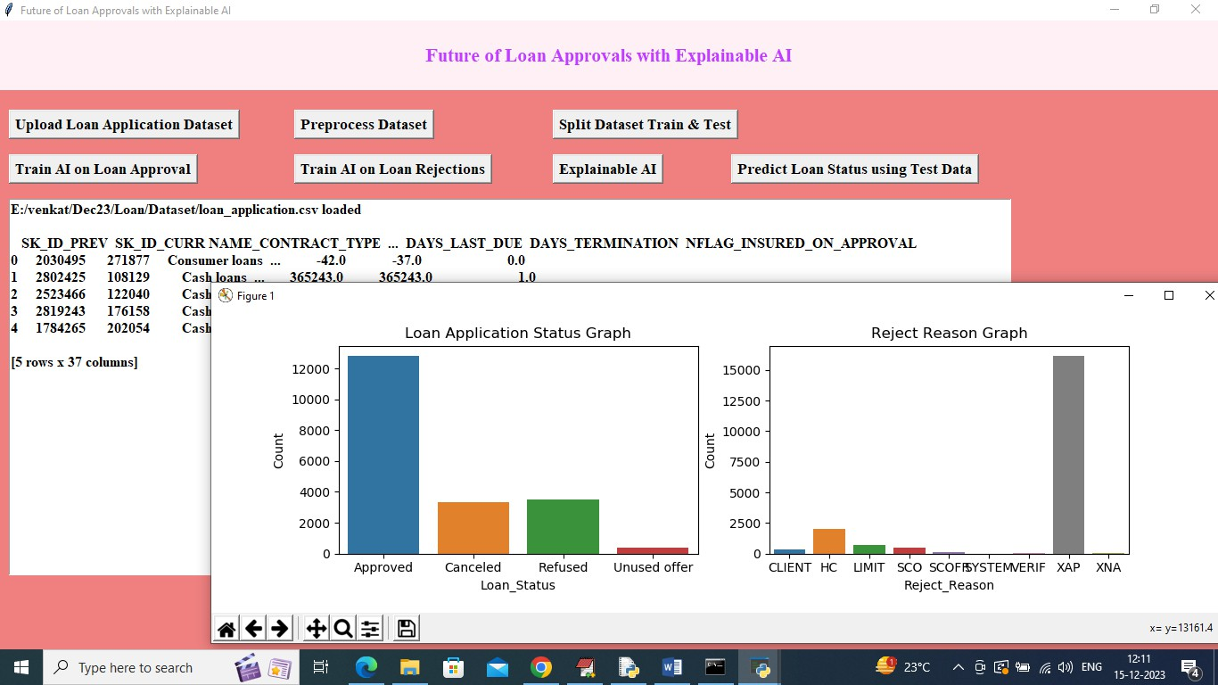
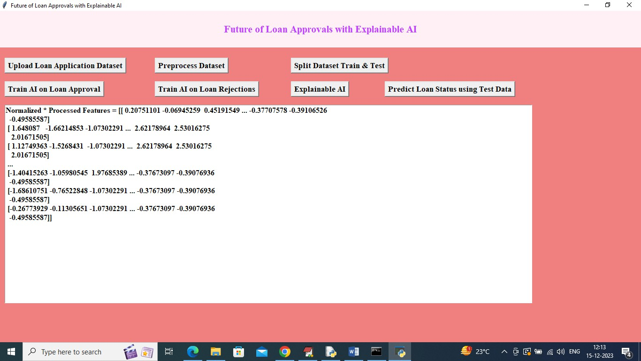
OU T P U T SCREENS

Slide 21
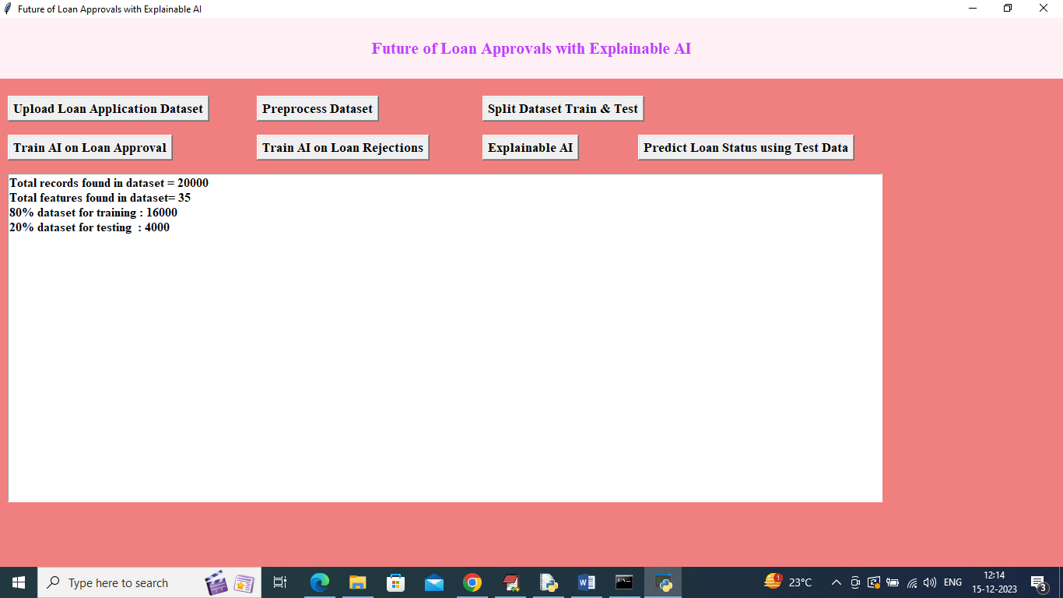
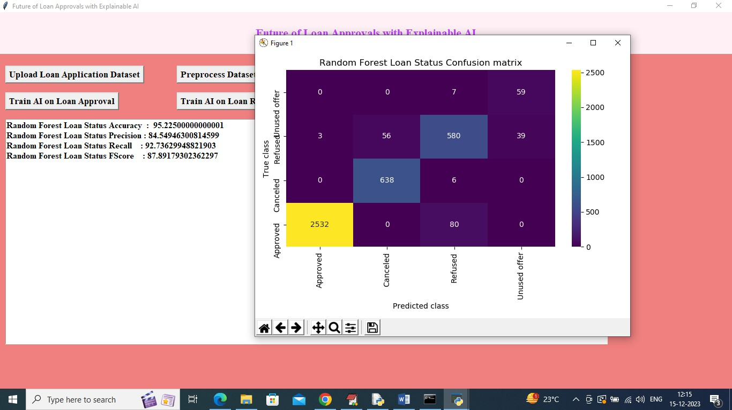
OU T P U T SCREENS

Slide 22
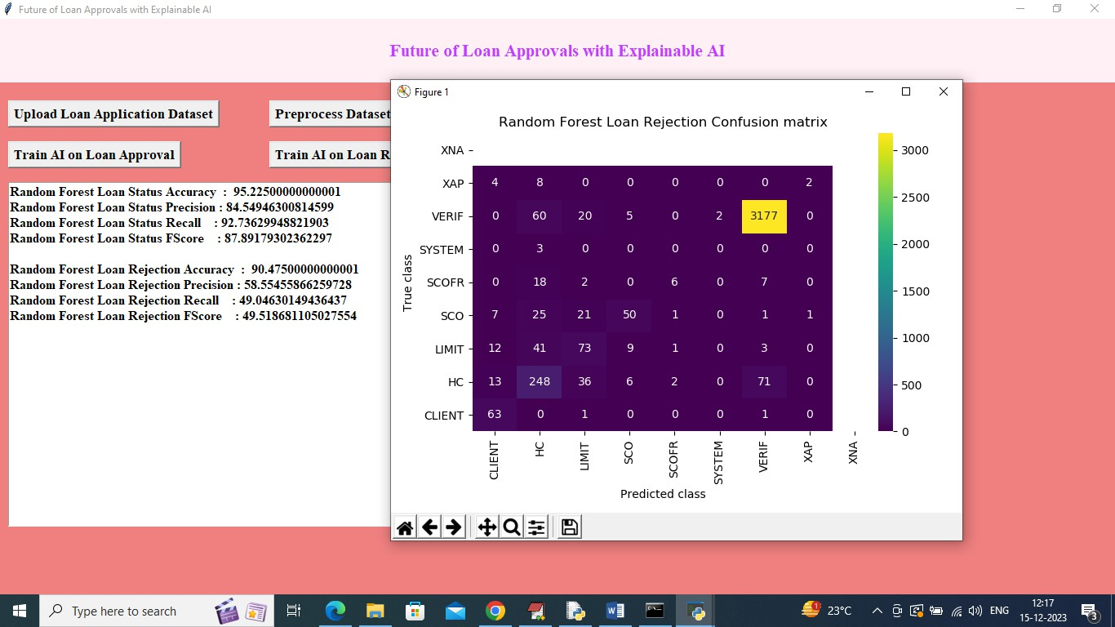
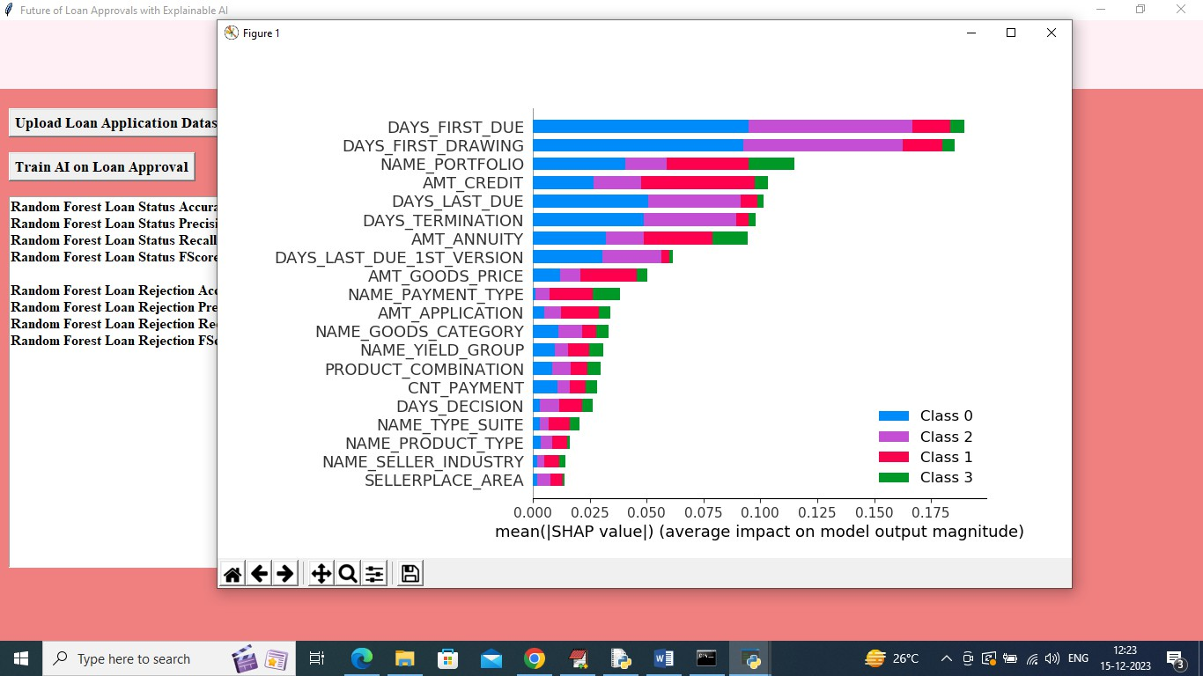
OU T P U T SCREENS

Slide 23

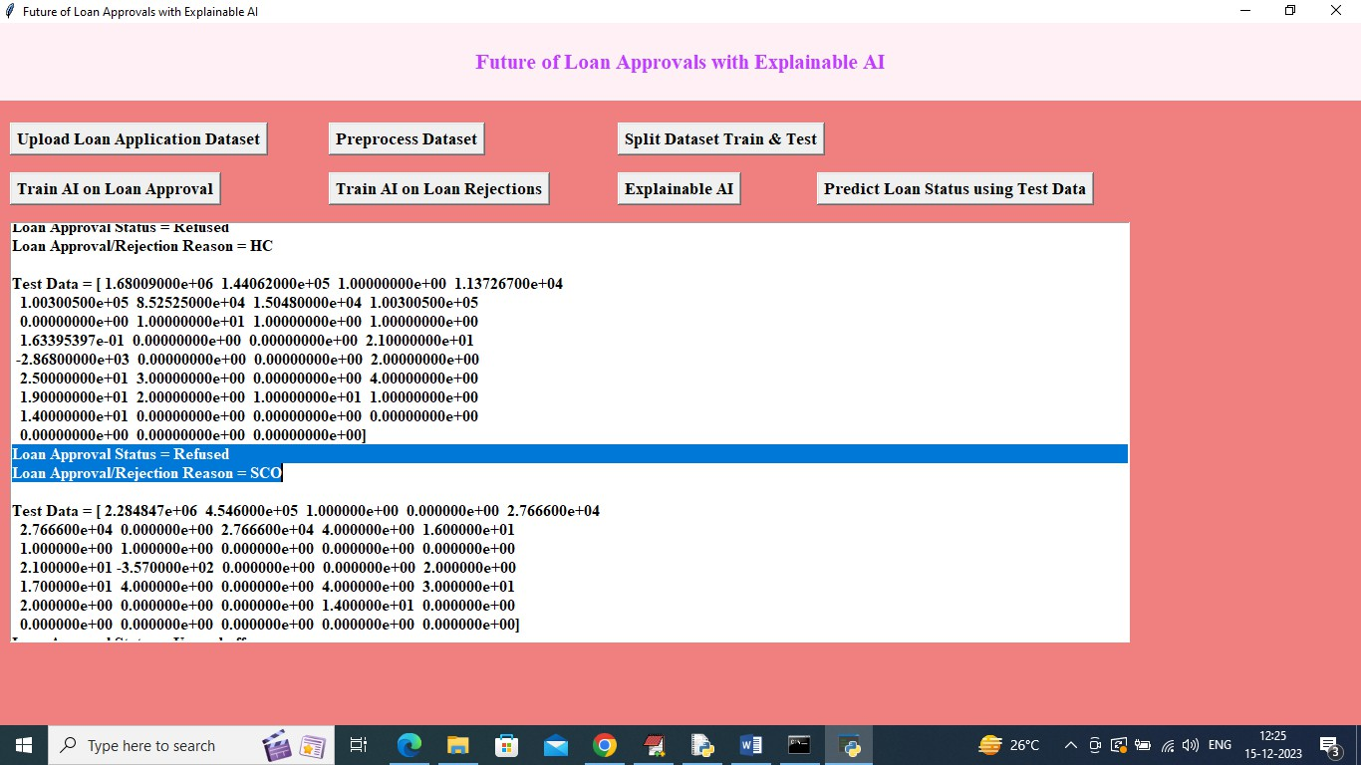
OU T P U T SCREENS

Slide 24
CONCLUSION
This project demonstrates the effectiveness of a Belief-Rule-Base (BRB) system as an explainable AI solution for automating the loan underwriting process. Unlike traditional "black-box" models, this system provides a transparent decision-making framework by integrating human expert knowledge with data-driven supervised learning. By highlighting the specific rules and attributes that trigger a loan approval or rejection, the system offers clear, actionable reasoning that can be easily communicated to applicants and non-technical stakeholders alike. Ultimately, this approach achieves a critical balance in financial technology: maintaining high predictive accuracy while ensuring the accountability and transparency required for executive deployment in regulated industries.

Slide 25
REFERENCES
1. Abdou, H. A. (2009). Genetic programming for credit scoring: The case of Egyptian public sector banks. Expert systems with applications, 36(9), 11402-11417.
2. Abellán, J., & Castellano, J. G. (2017). A comparative study on base classifiers in ensemble methods for credit scoring. ,. Expert Systems with Applications, 73, 1-10.
3. Adadi, A., & Berrada, M. (2018). Peeking inside the black-box: A survey on Explainable Artificial Intelligence (XAI). IEEE Access, 6, 52138-52160.
4. Aggour, K. S., Bonissone, P. P., Cheetham, W. E., & Messmer, R. P. (2006). Automating the underwriting of insurance applications. AI magazine, 27(3), 36-36.
Aitken, R. (2017).'All data is credit data': Constituting the unbanked. Competition & Change. 21(4), 274- 300.
5. Akinyokun, O. C. (2015). Fuzzy logic-driven expert system for the diagnosis of heart failure disease. Artif. Intell. Research, 12-21.
6. Ala'raj, M., & Abbod, M. F. (2016). Classifiers consensus system approach for credit scoring. Knowledge-Based Systems, 104, 89-105.

Slide 26
THANK YOU!!

